Slide 1
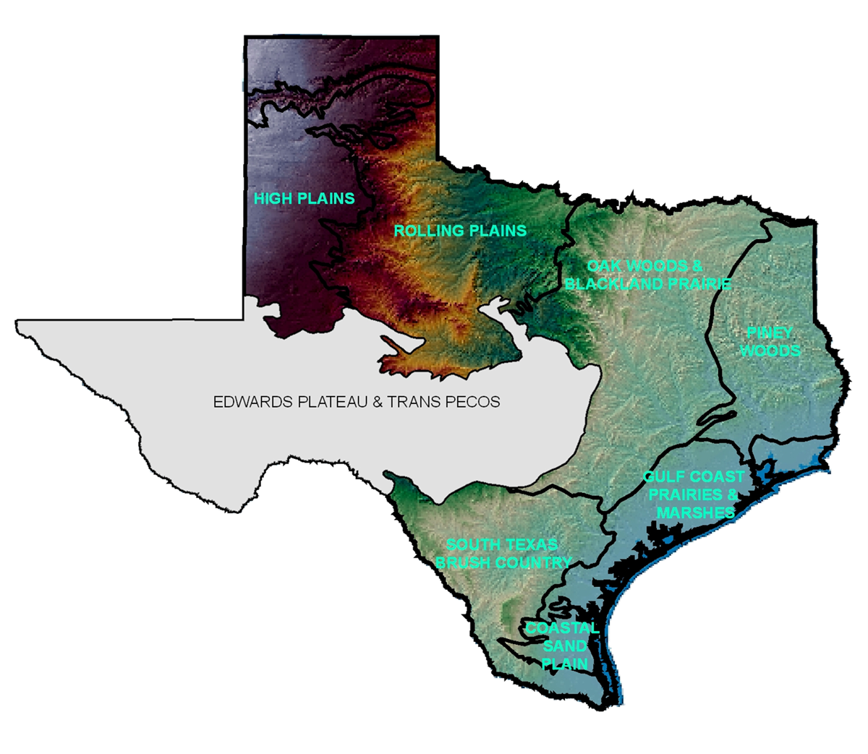
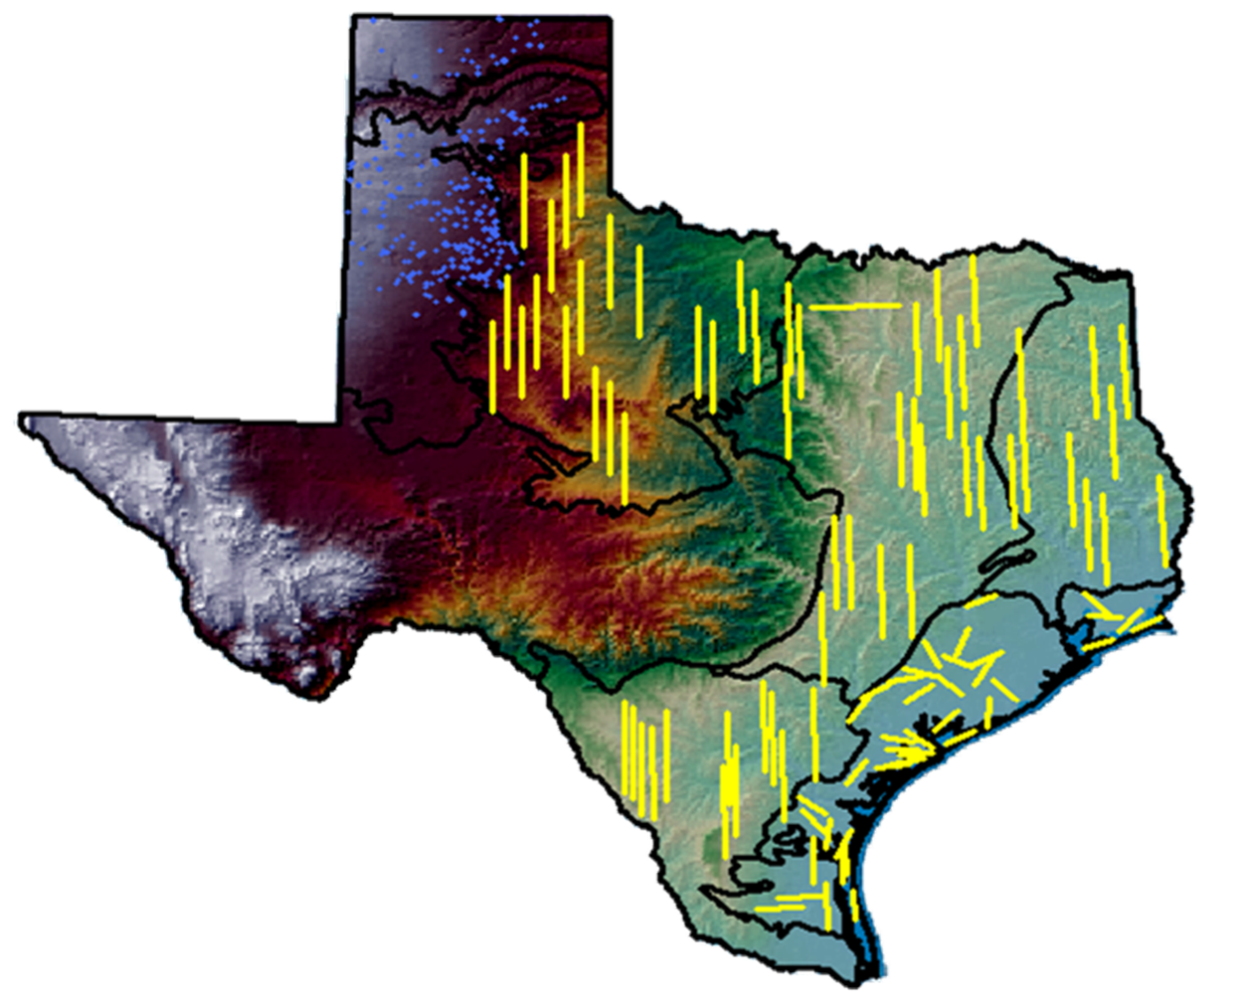


Texas Midwinter Waterfowl Survey Estimates
A Multi Year Summary by Ecoregion

Slide 2
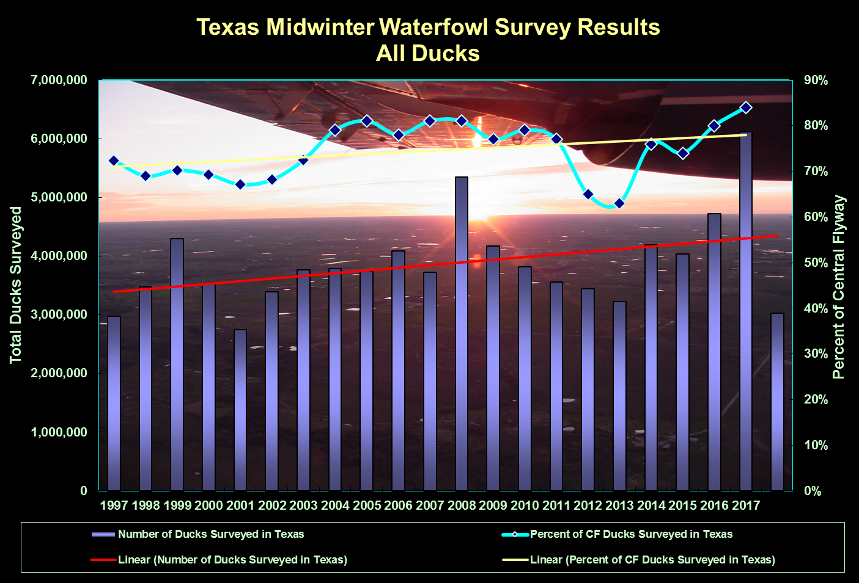

Slide 4
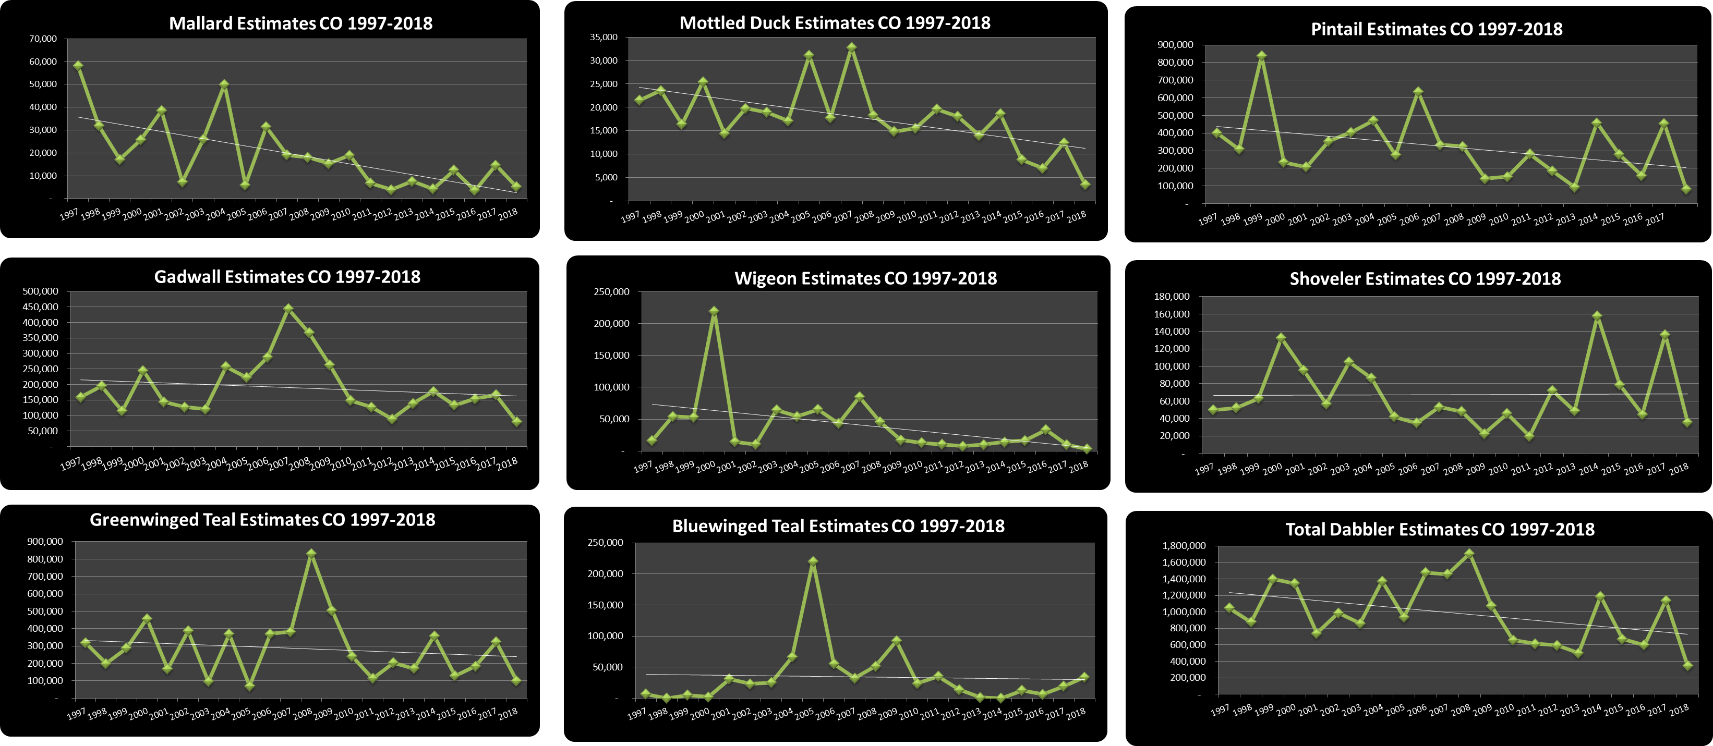
Gulf Coast Prairies and Marshes

Slide 5
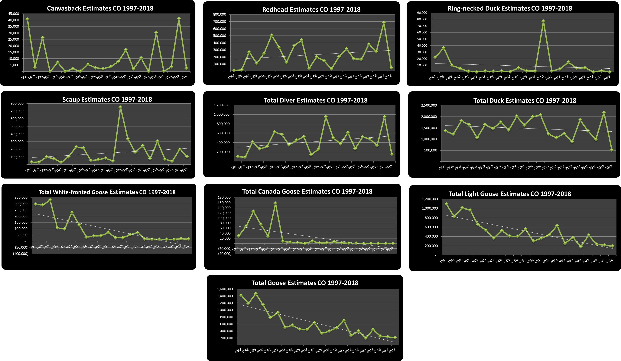
Gulf Coast Prairies and Marshes

Slide 6
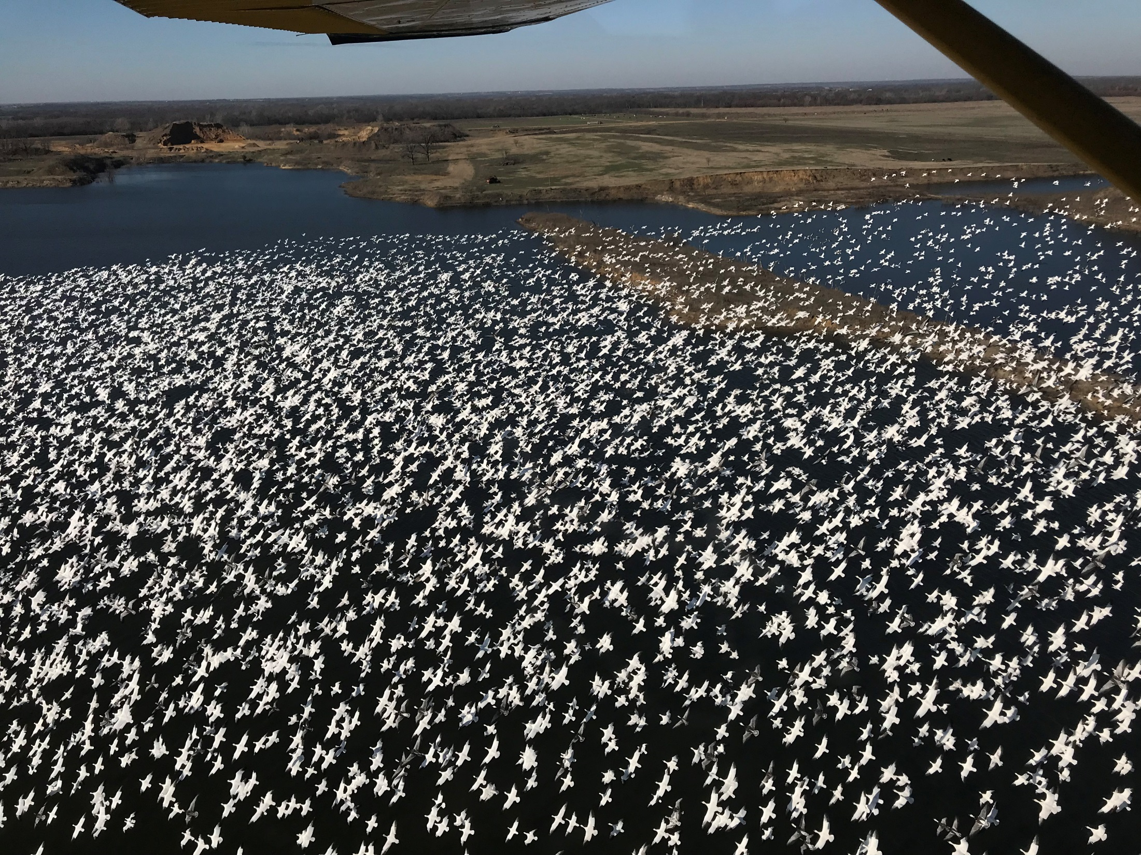

Slide 7
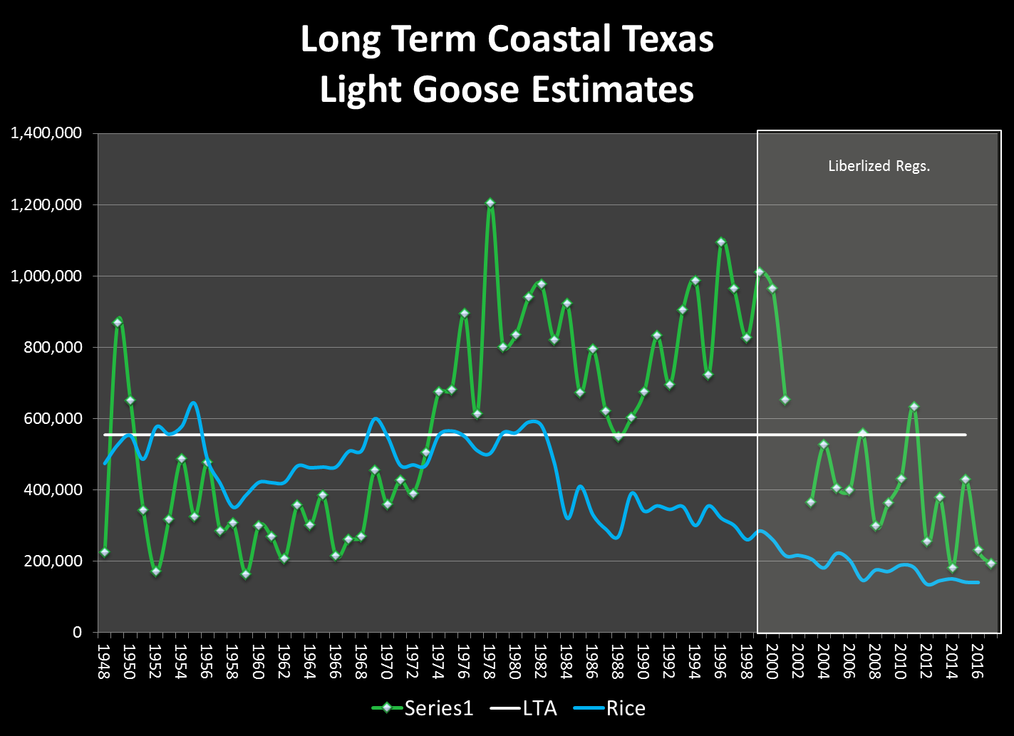

Slide 9
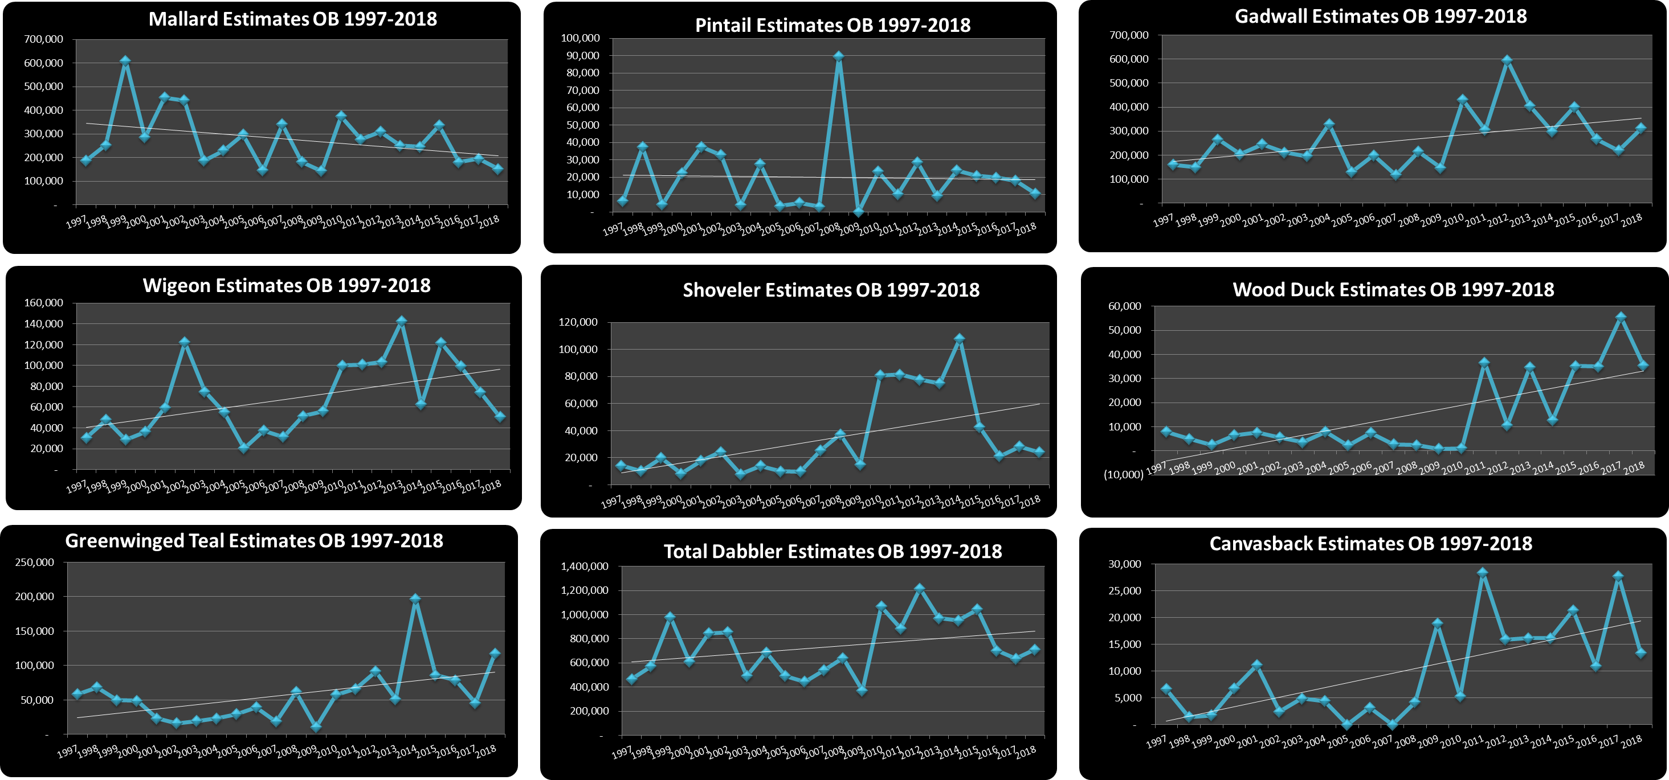
Oak Woods/Blackland Prairie

Slide 10
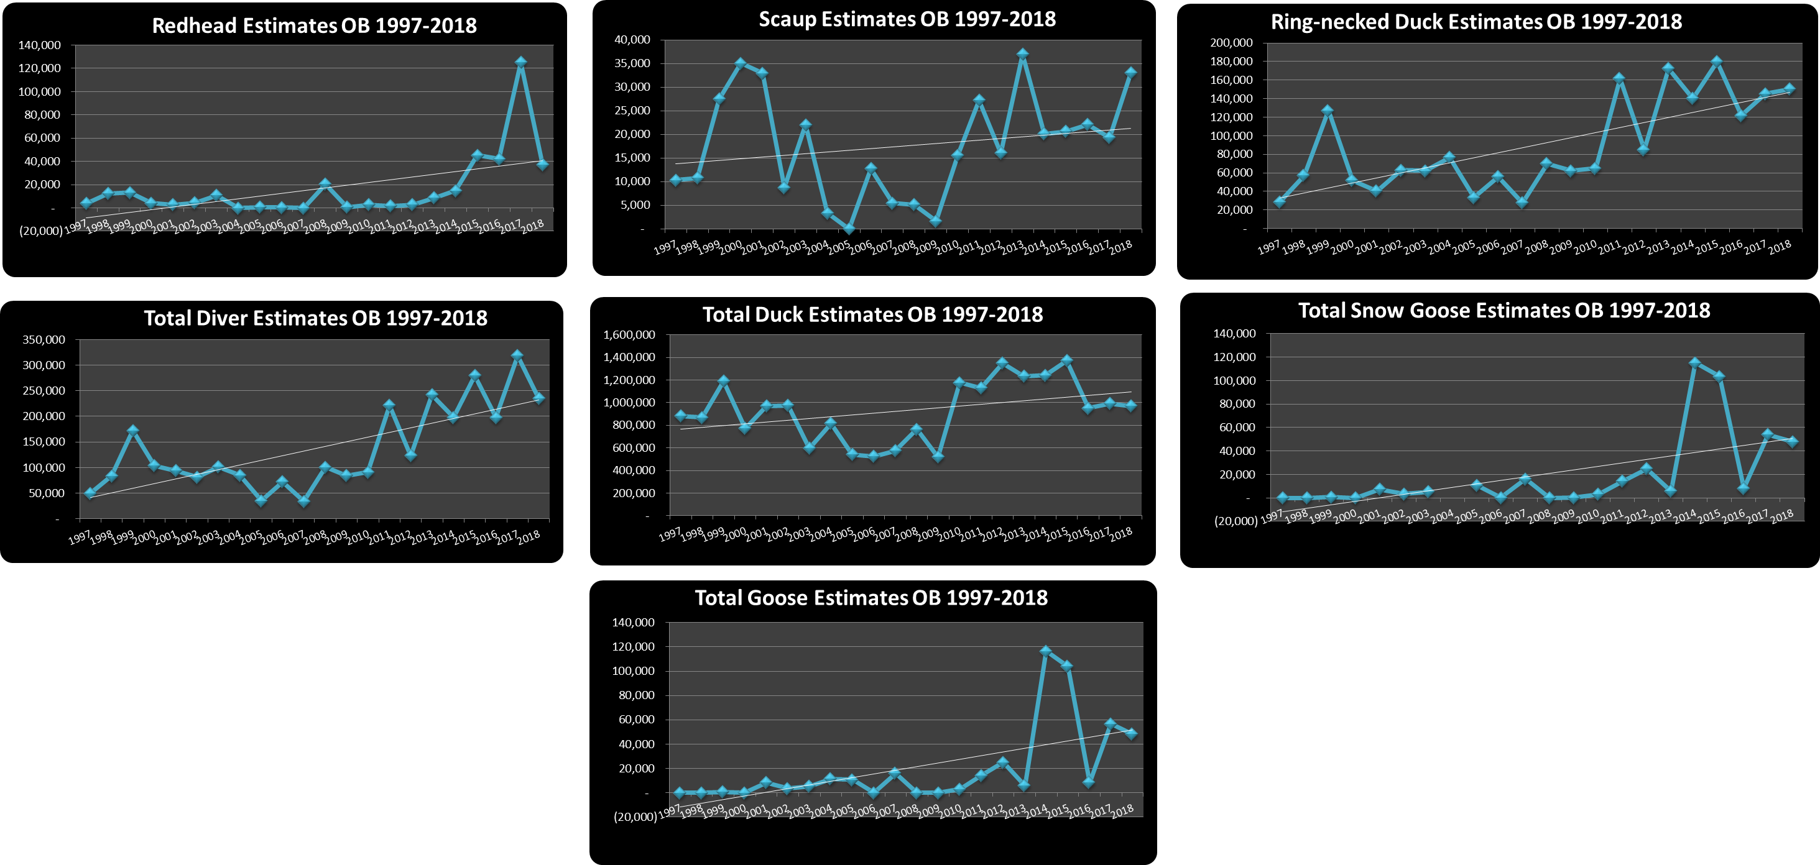
Oak Woods/Blackland Prairie

Slide 12

High Plains

Slide 13

High Plains

Slide 15
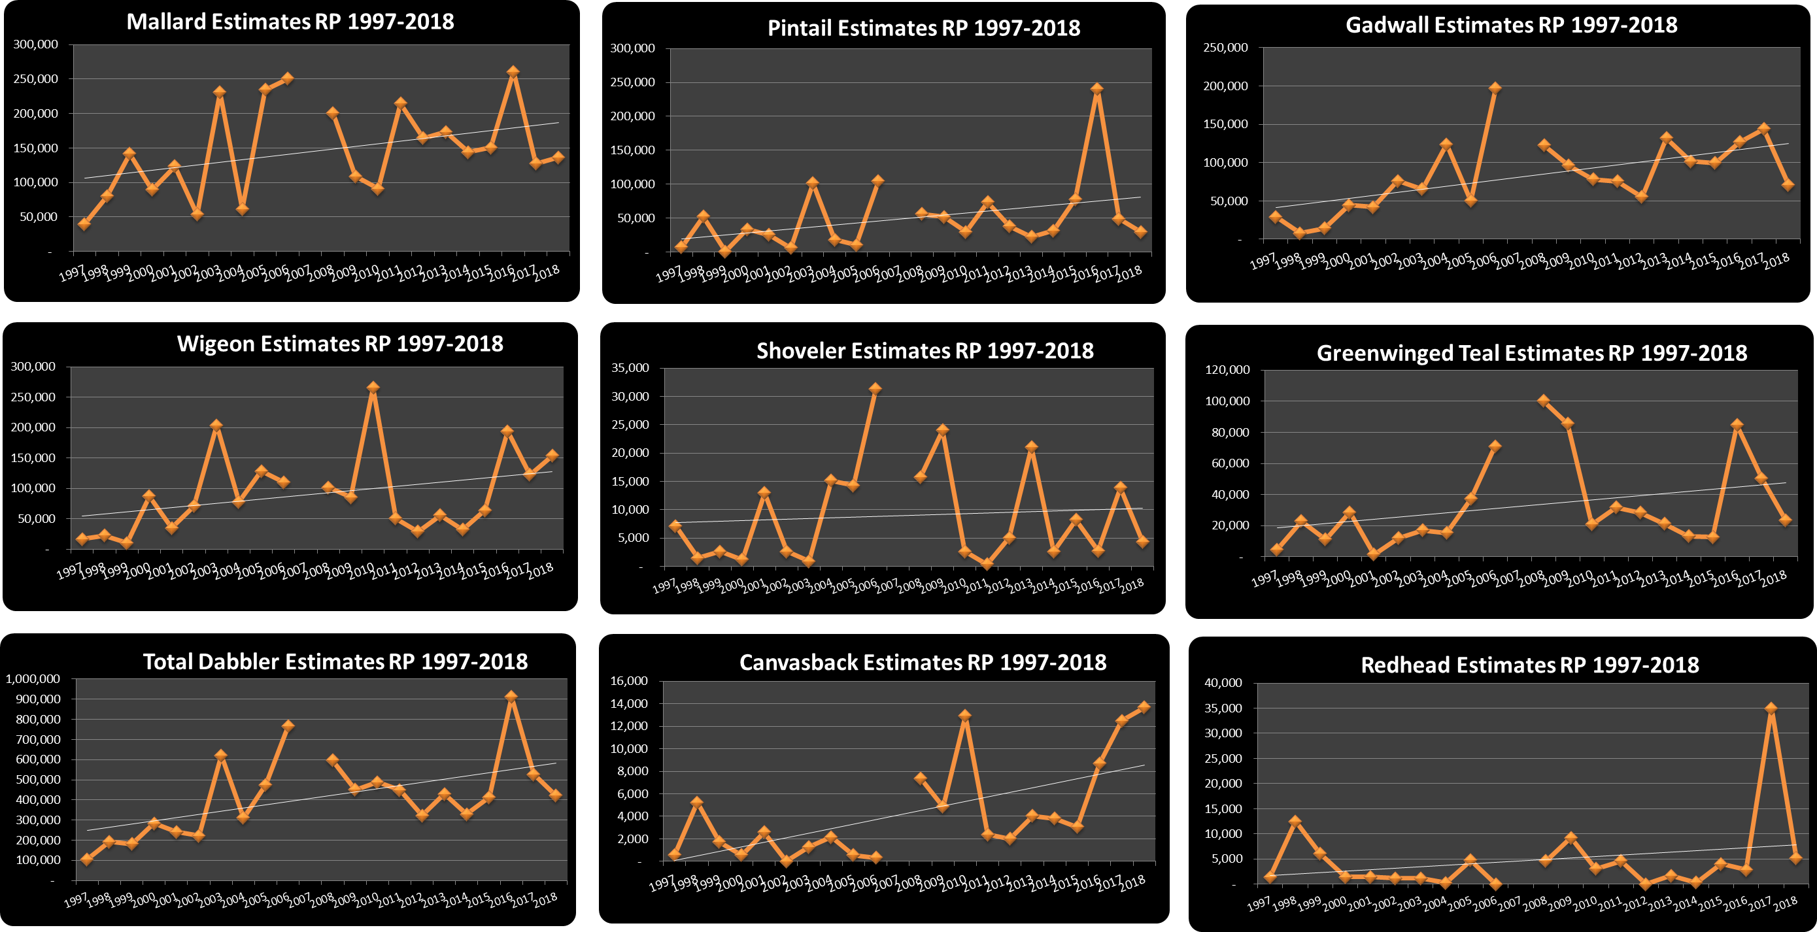
Rolling Plains

Slide 16
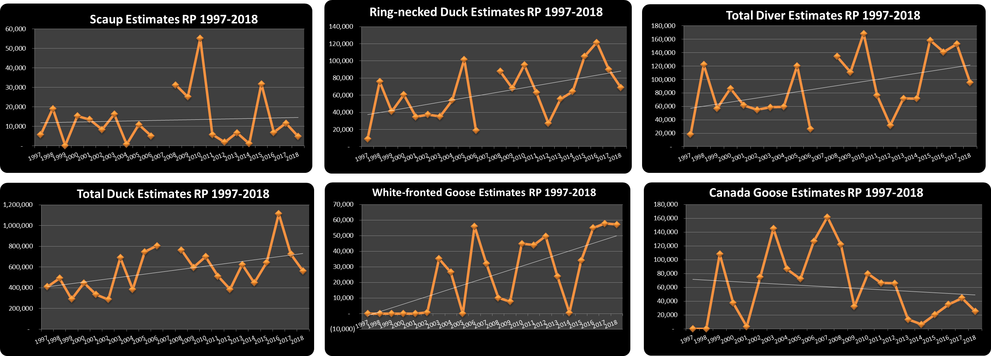

Rolling Plains

Slide 18
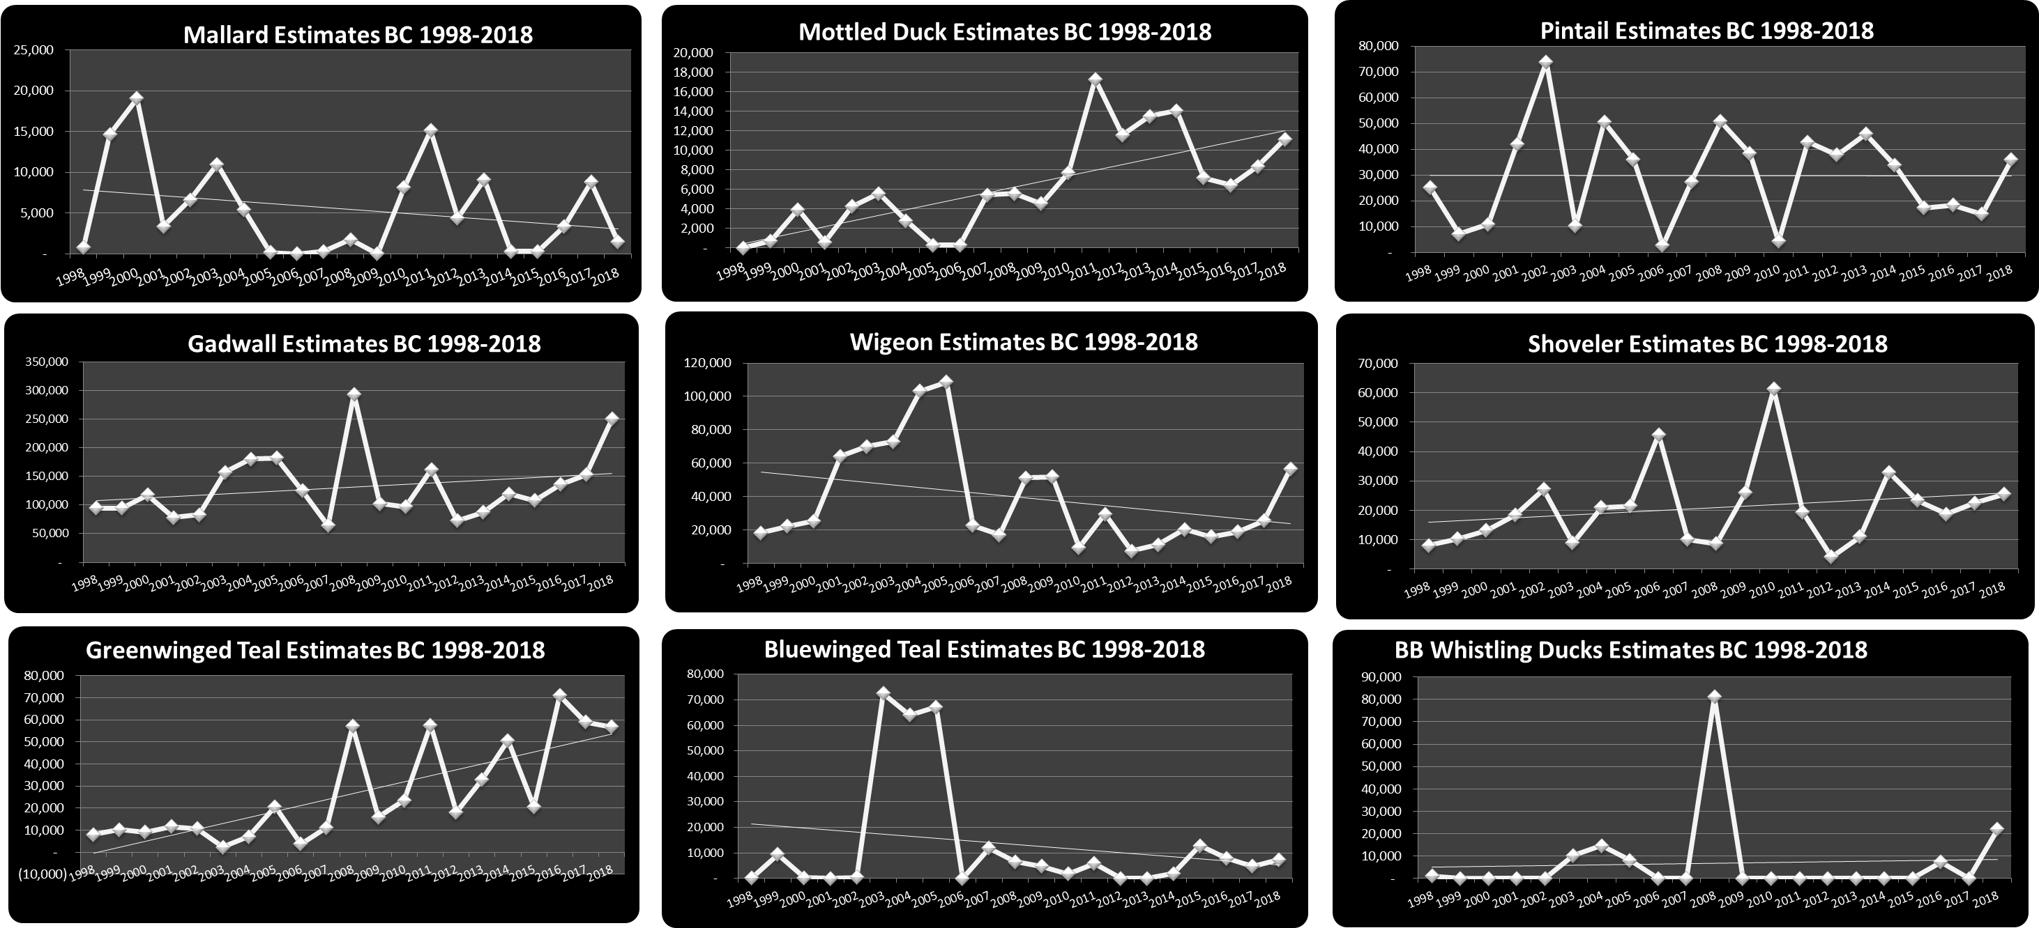
South Texas Brush Country

Slide 19
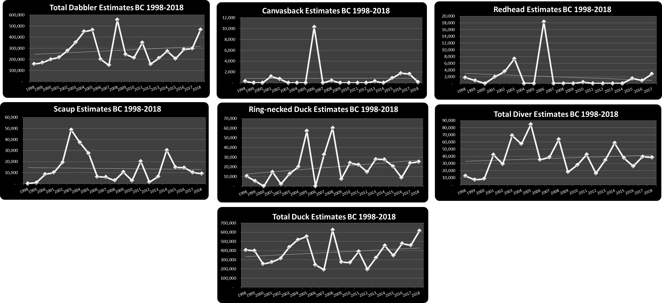
South Texas Brush Country

Slide 21

Piney Woods

Slide 22

Piney Woods

Slide 24

Coastal Sand Plain

Slide 25

Coastal Sand Plain

Slide 27

State Totals

Slide 28

State Wide Totals

Slide 29
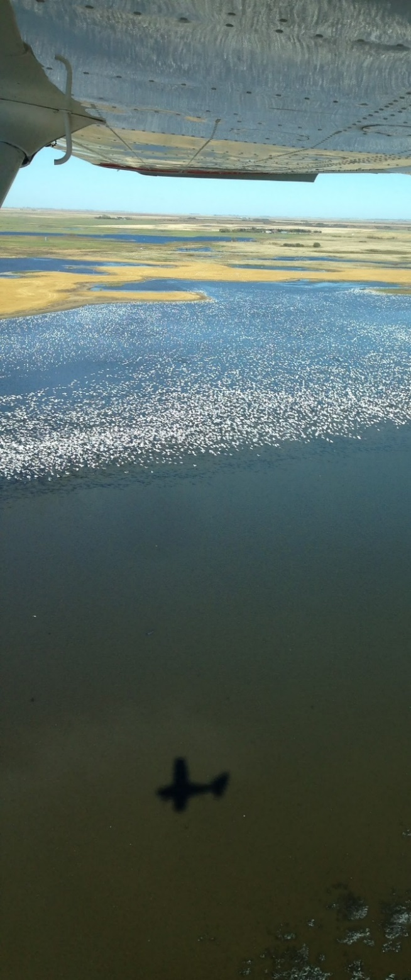
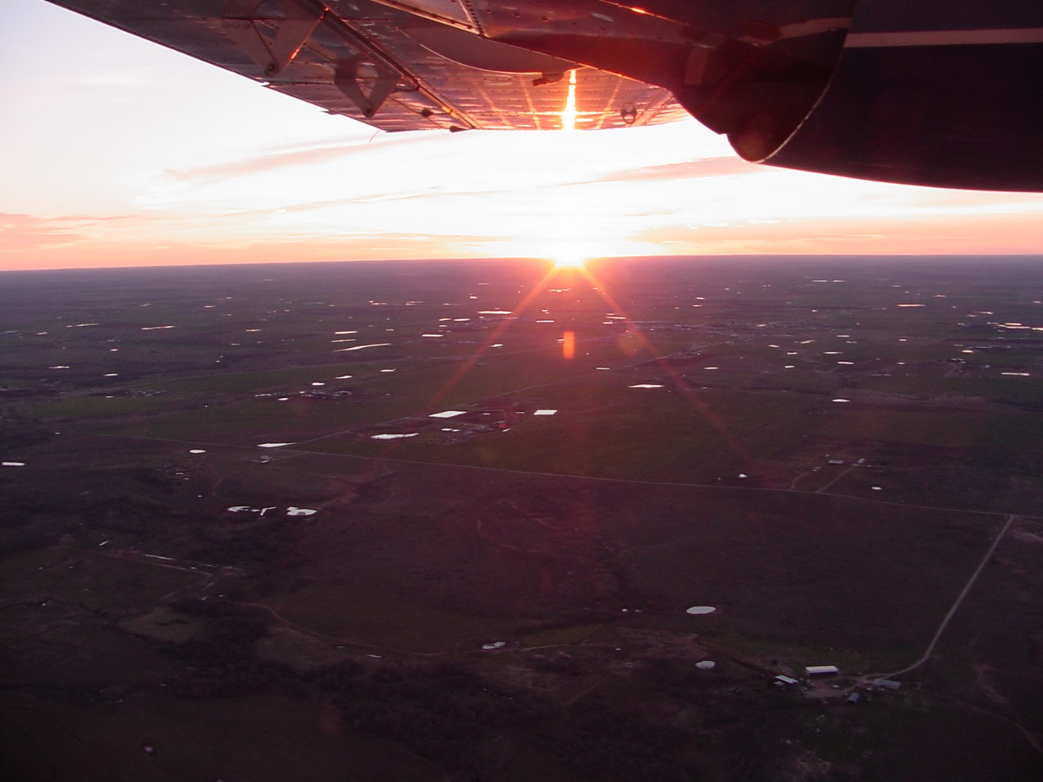
Texas Midwinter Waterfowl Survey
Annual Summaries

Slide 30
1997

Slide 31
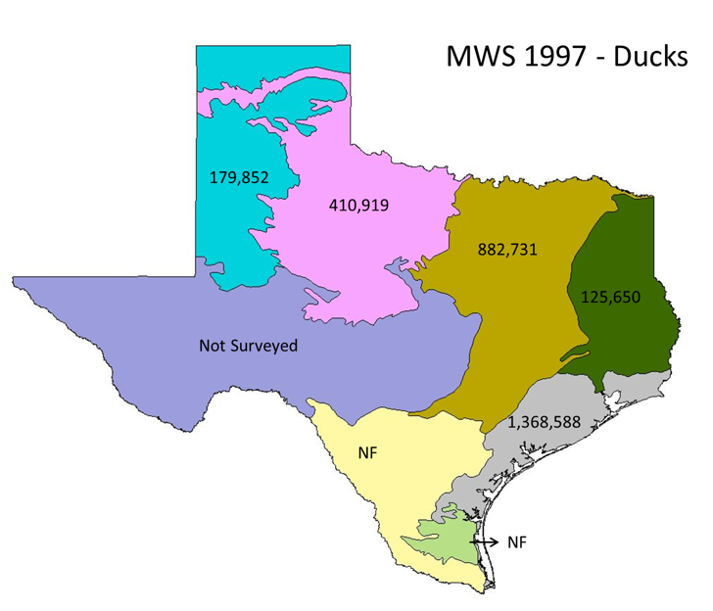

Slide 32
1998

Slide 33
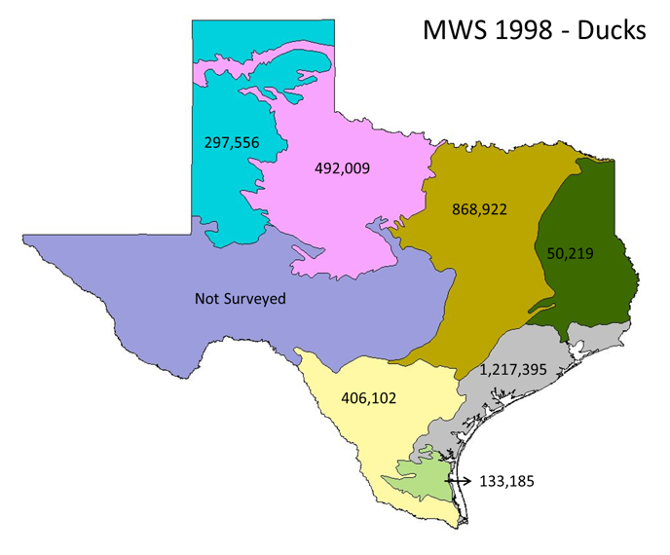

Slide 34
1999

Slide 35
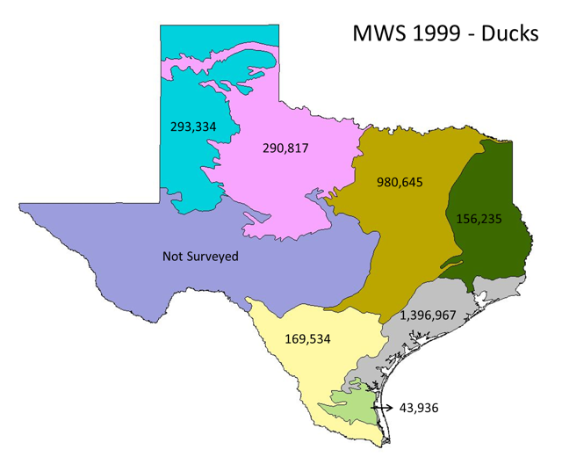

Slide 36
2000

Slide 37
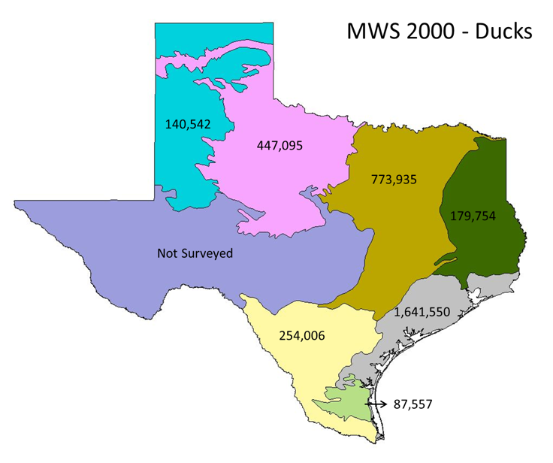

Slide 38
2001

Slide 39
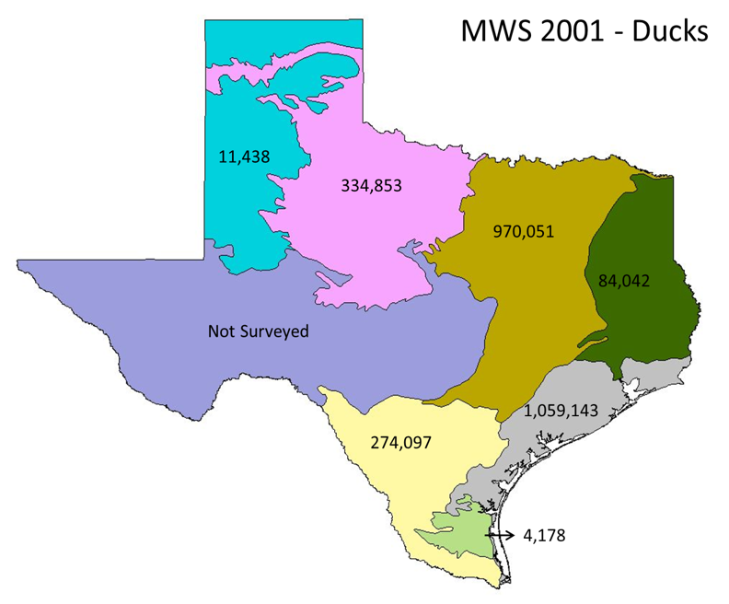

Slide 40
2002

Slide 41
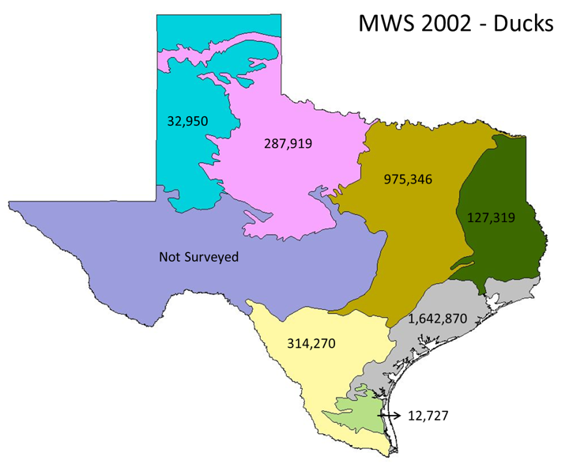

Slide 42
2003

Slide 43
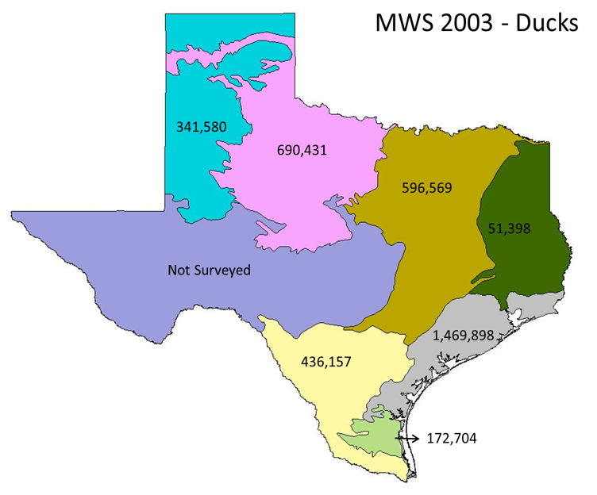

Slide 44
2004

Slide 45
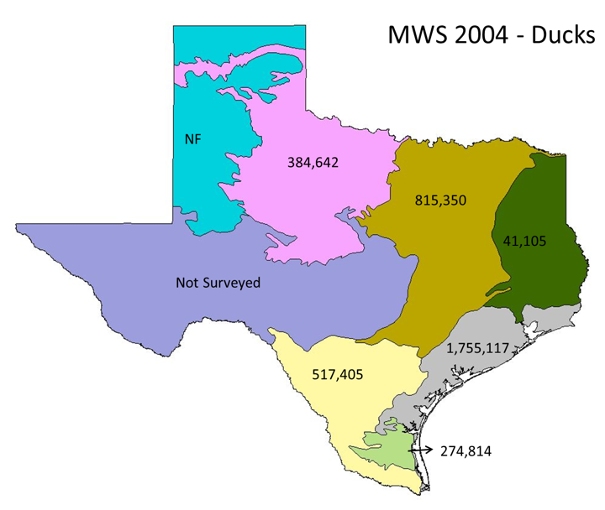

Slide 46
2005

Slide 47
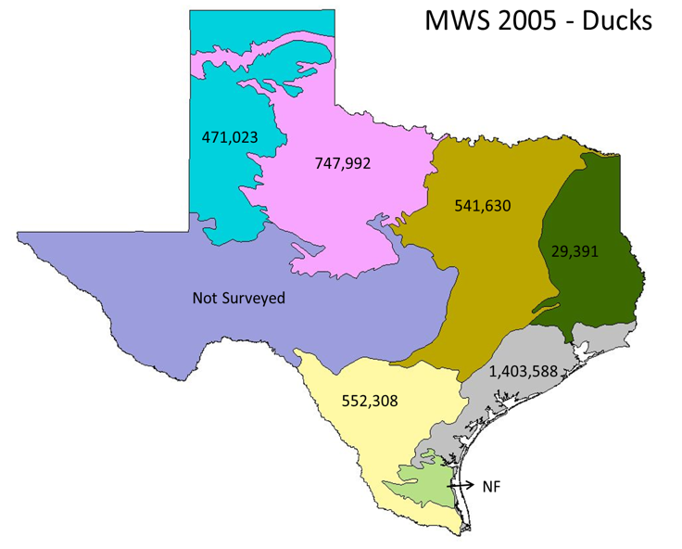

Slide 48
2006

Slide 49
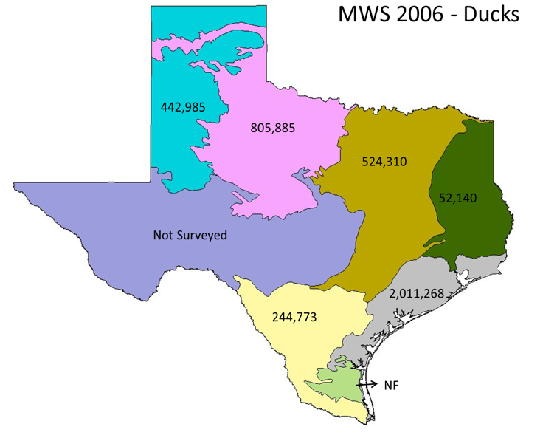

Slide 50
2007

Slide 51


Slide 52
2008

Slide 53
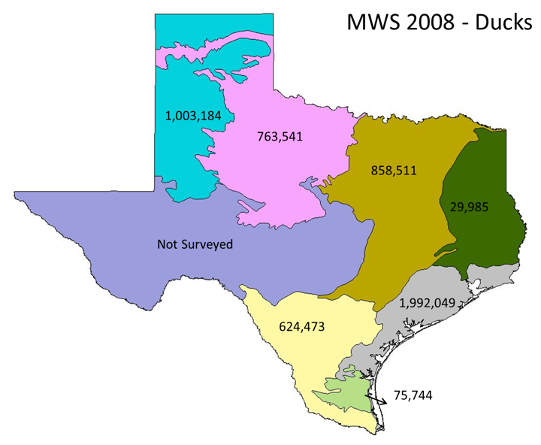

Slide 54
2009

Slide 55


Slide 56
2010

Slide 57
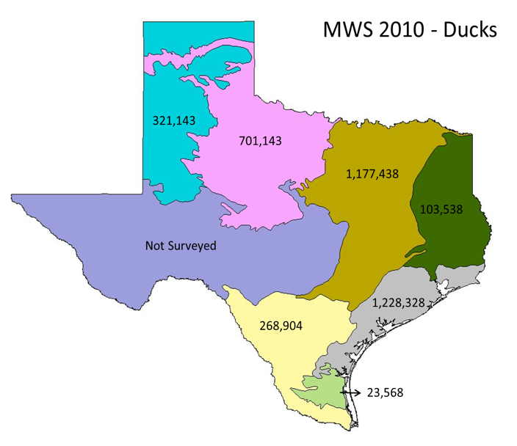

Slide 58
2011

Slide 59
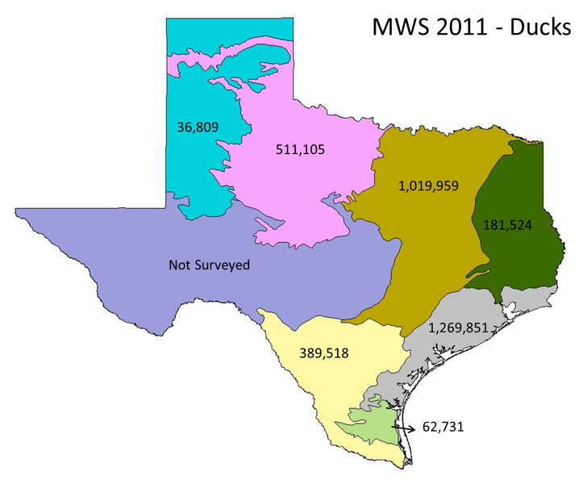

Slide 60
2012

Slide 61


Slide 62
2013

Slide 63
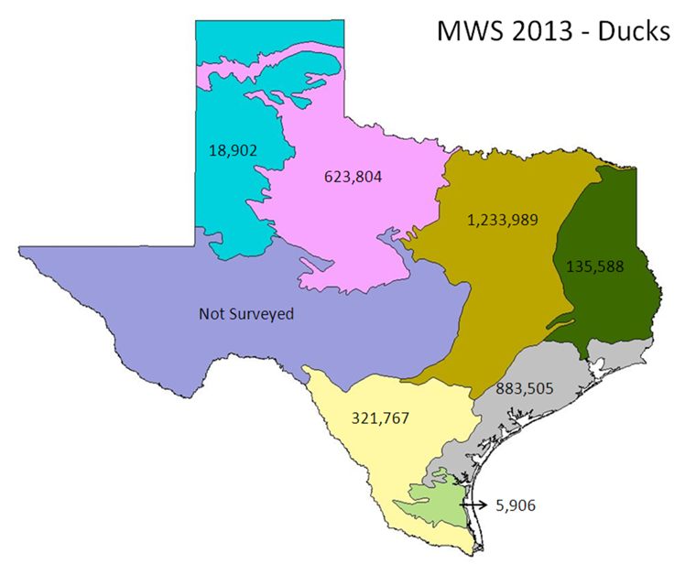

Slide 64
2014

Slide 65


Slide 66
2015

Slide 67
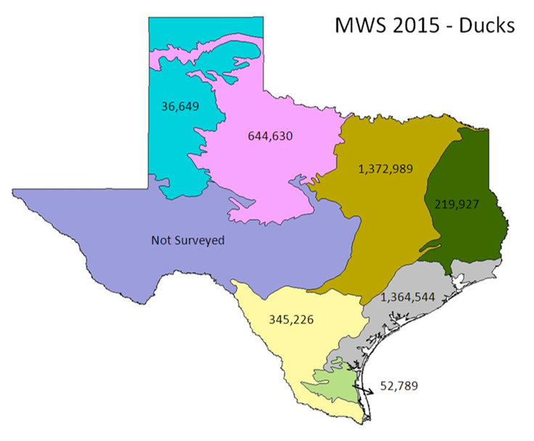

Slide 68
2016

Slide 69


Slide 70
2017

Slide 71
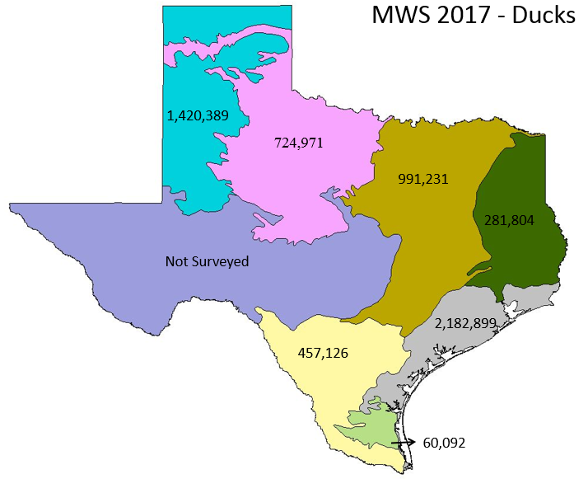

Slide 72


Slide 73
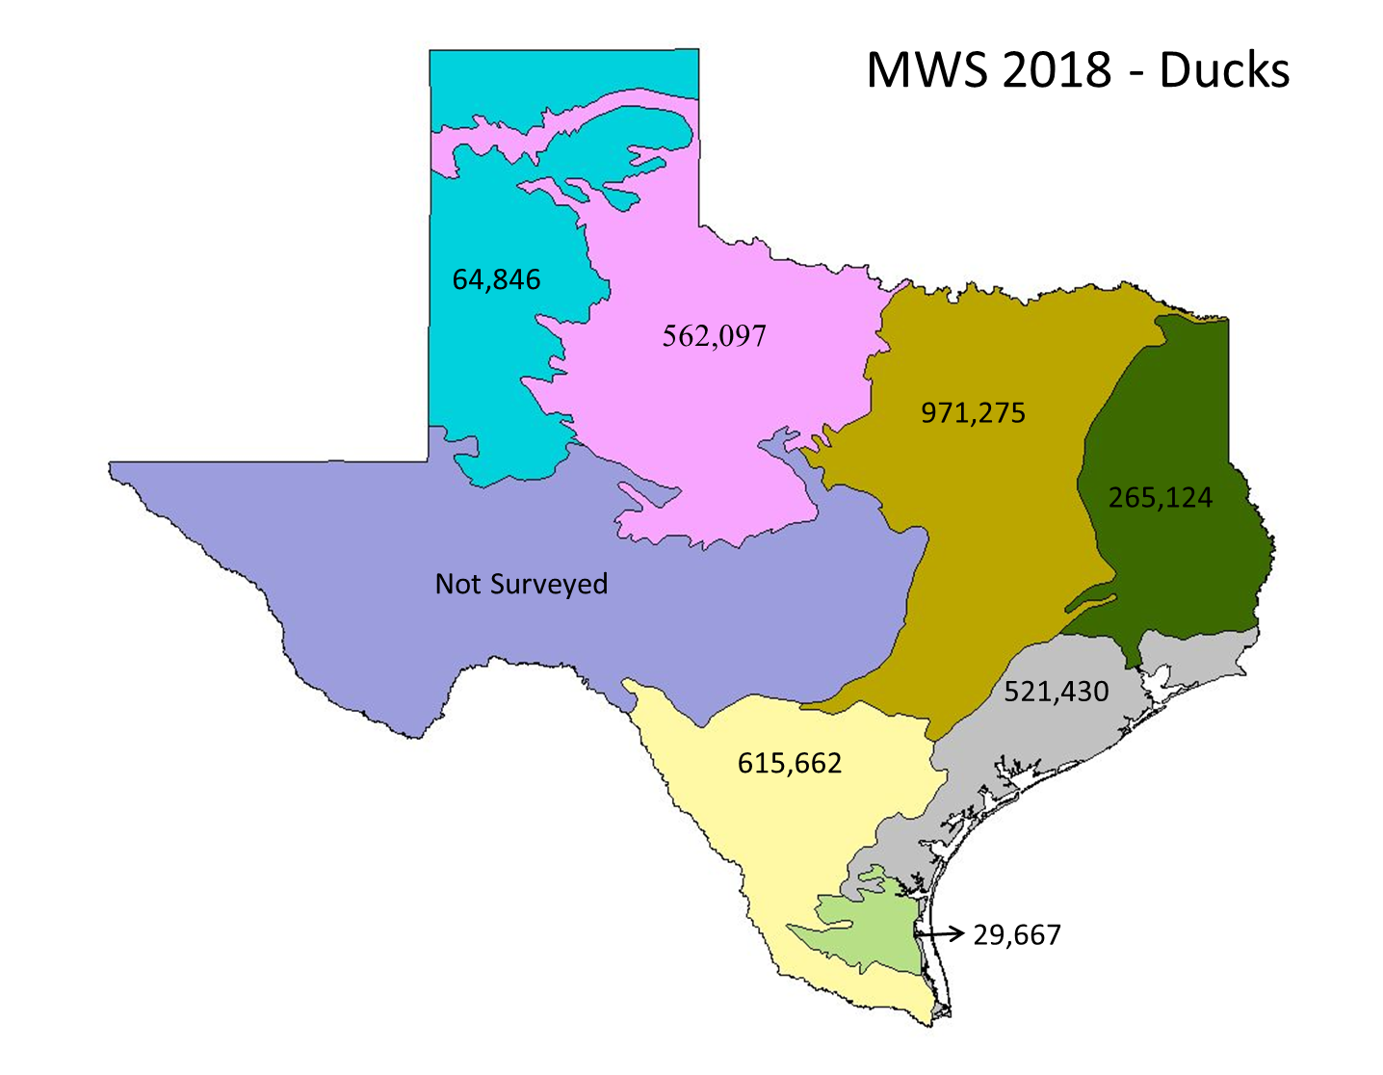

Slide 74



